Slide 1
Instructions for the Function Classification Analysis

Slide 2
Instructions
For each figure, you should look at the subject’s function (shown in red) and then classify it into one of five categories
1) Linear
2) Quadratic
3) Cubic
4) Similarity-based
5) Other/Unclassified
To display all the figures for a given subject, go to the folder: C:\Documents and Settings\littled\My Documents\My Dropbox\Dan's Experiments\2013 Function Classification
Type: showSubjectData(m)
Where m is the subject number you want to see. Subject numbers go from 1 to 170. If one doesn’t work, just continue to the next one.

Slide 3
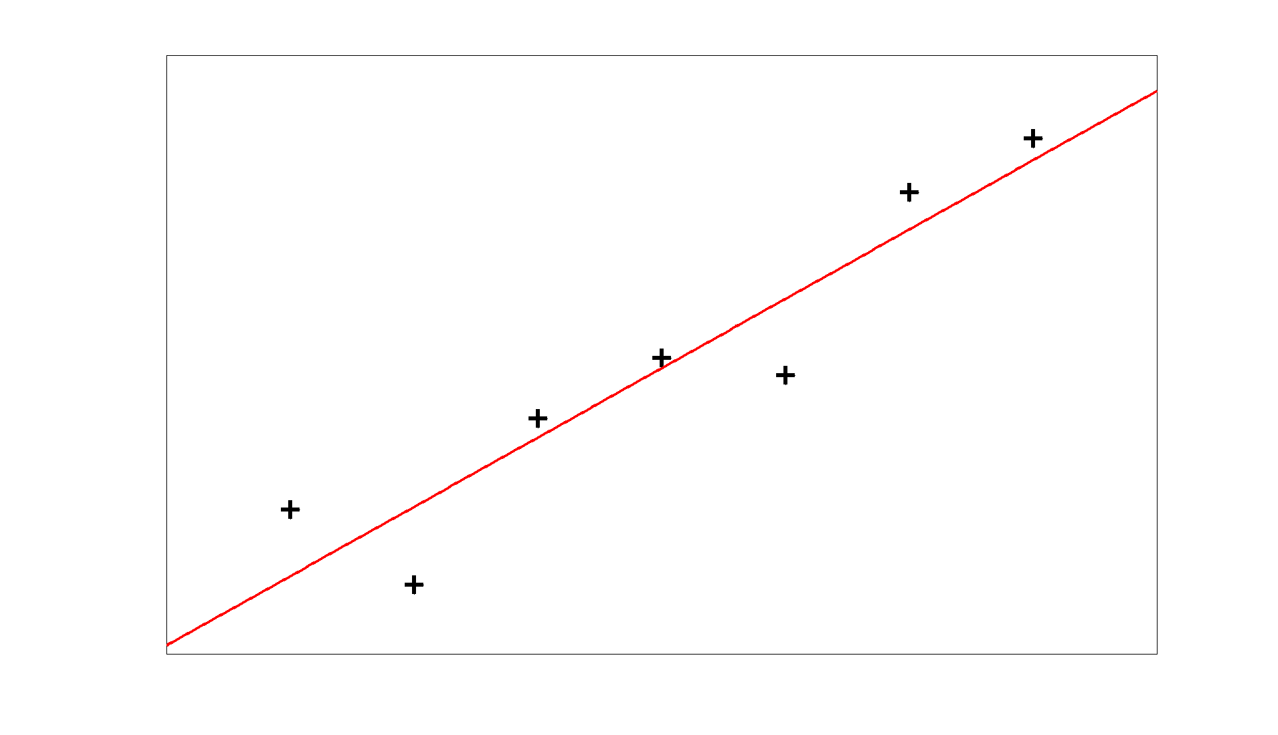
1) Linear Functions
Linear functions will be basically straight lines. They may vary in their slope or their intercept. By basically straight, I mean allow some variation to account for the fact that people are drawing these by hand. That is, the function should generally look straight but may be a little noisy.

Slide 4
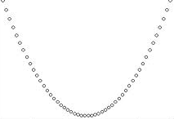
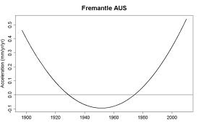
2) Quadratic Functions
Quadratic functions will have a single “bump”. They may be pointed up or down, and they may be more peaked or more shallow. Again, you should allow for the functions to be somewhat noisy since they’re drawn by hand.

Slide 5
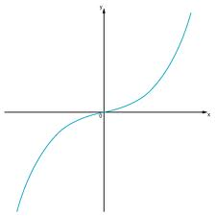
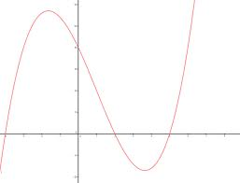
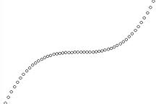
3) Cubic Functions
Cubic functions will have a two “bumps”. Again, they may be more peaked or more shallow. Again, you should allow for the functions to be somewhat noisy since they’re drawn by hand.

Slide 6
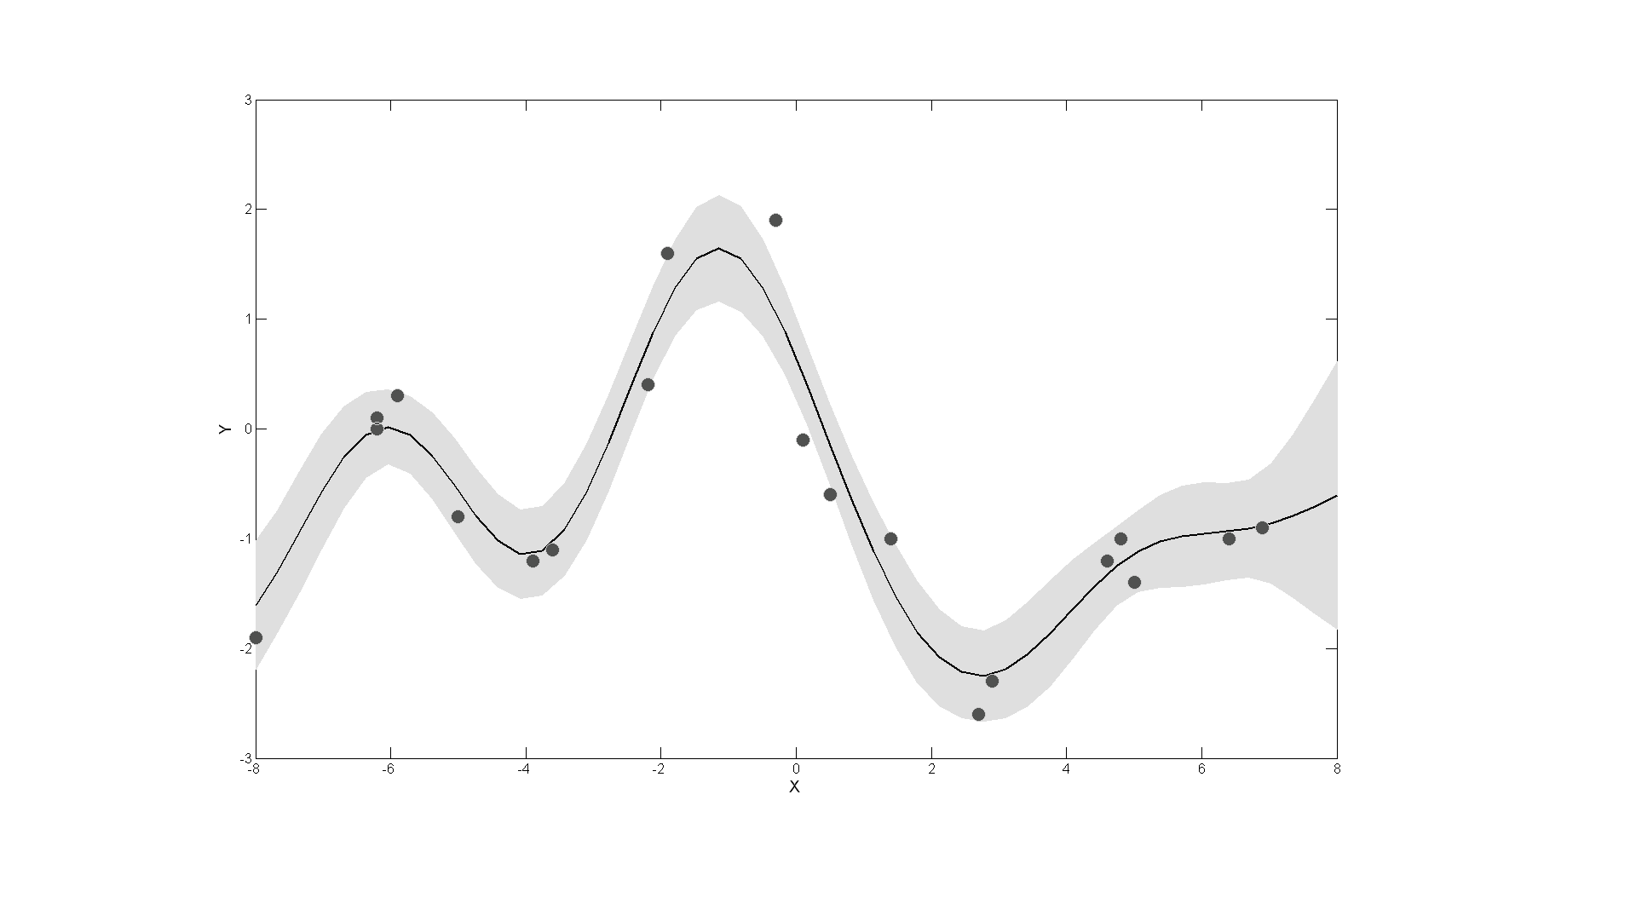
4) Similarity-based Functions
The similarity-based model generates functions based on locally-averaging the nearby points. Functions generated from this model will appear to “track” the data. Extreme versions of this type of function will just connect the dots

Slide 7
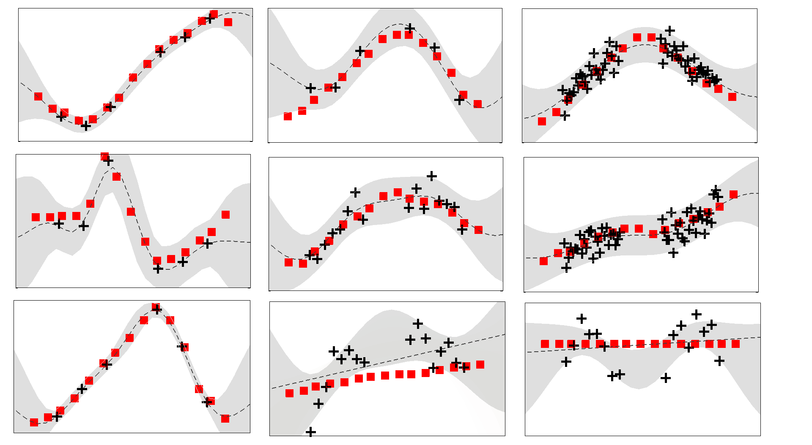
4) Some more examples

Slide 8
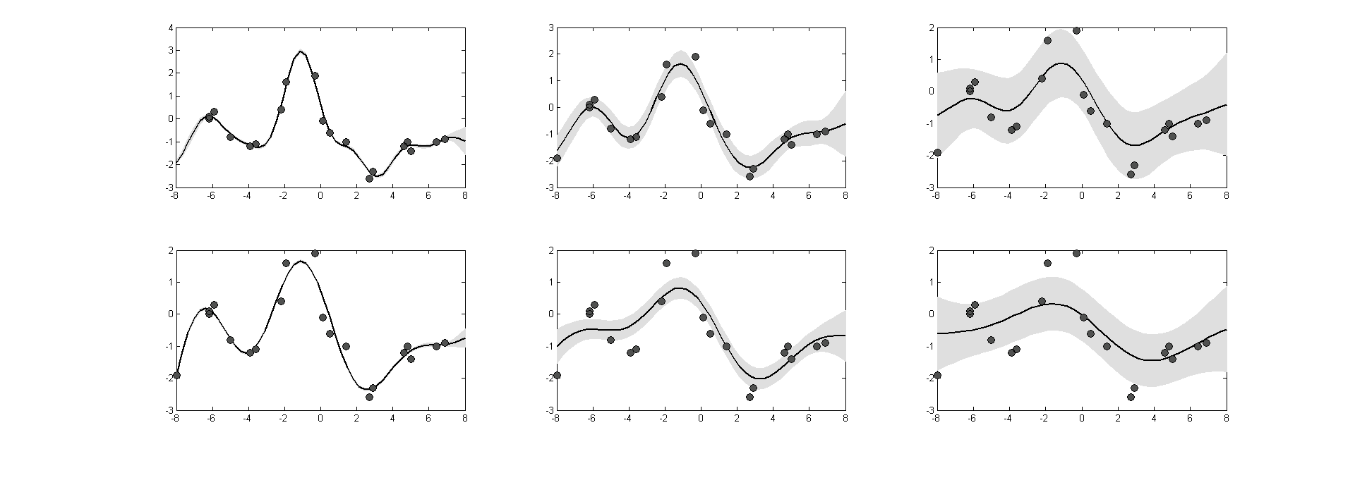
4) Varying the parameters
Keep in mind that these functions do not have to fall on every data point (see the functions on the right). It is sufficient for a function to be merely influenced by the local changes in the data in order for it to fall in this class.

Slide 9
5) Other/Unclassified
Finally, you may run into the rare function which doesn’t fit one of these categories. Just mark that one as #5

Slide 10
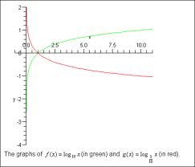
6) Log Graph/ Exponential

